Slide 1
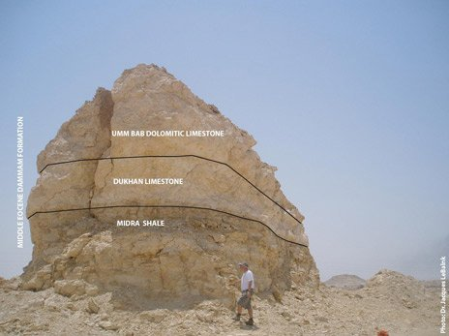
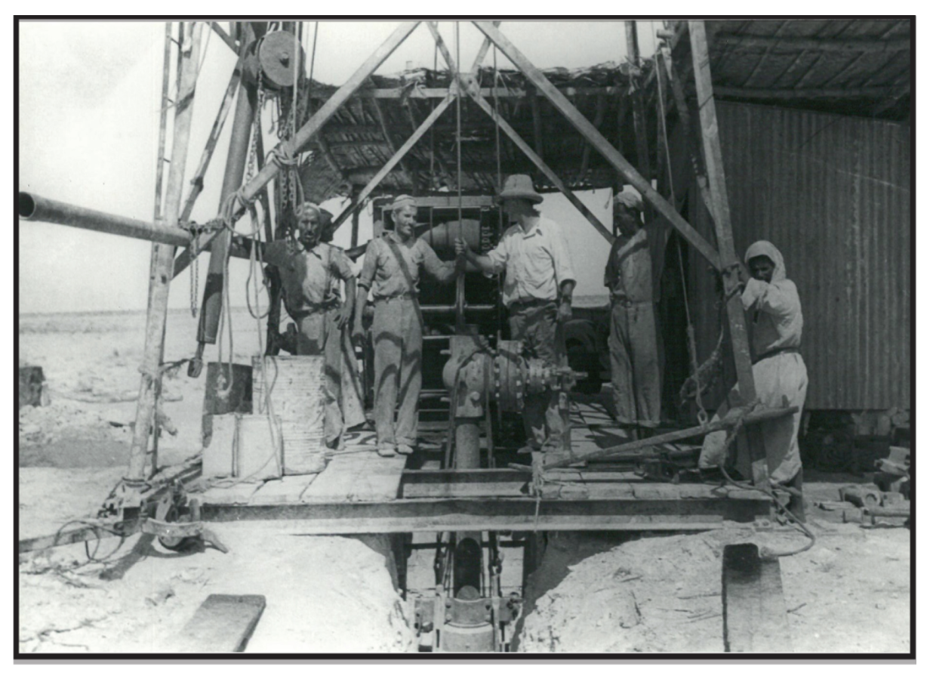
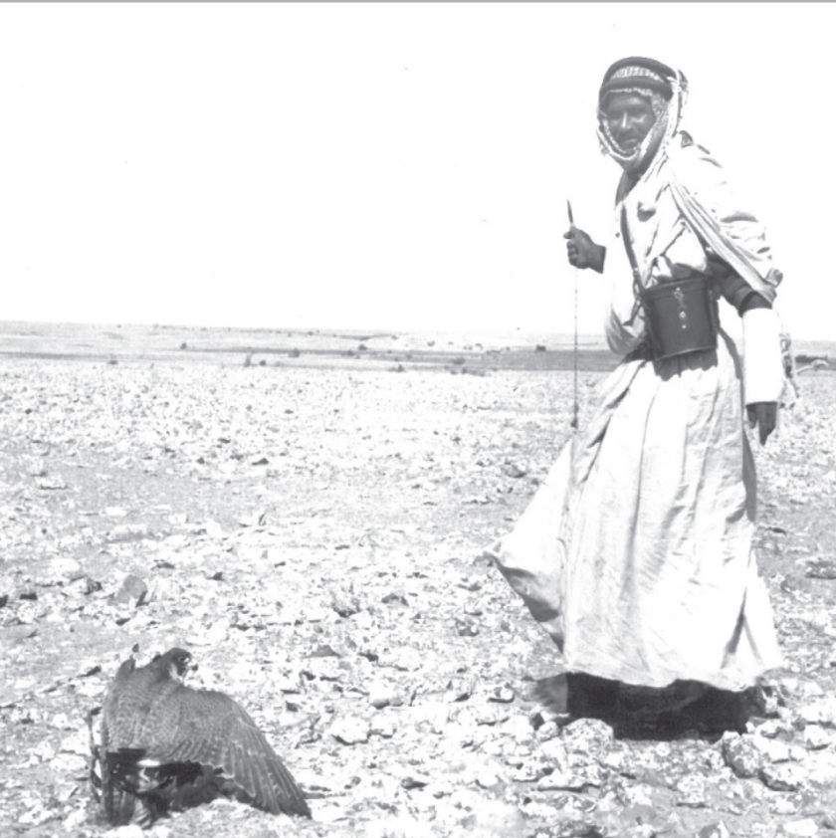
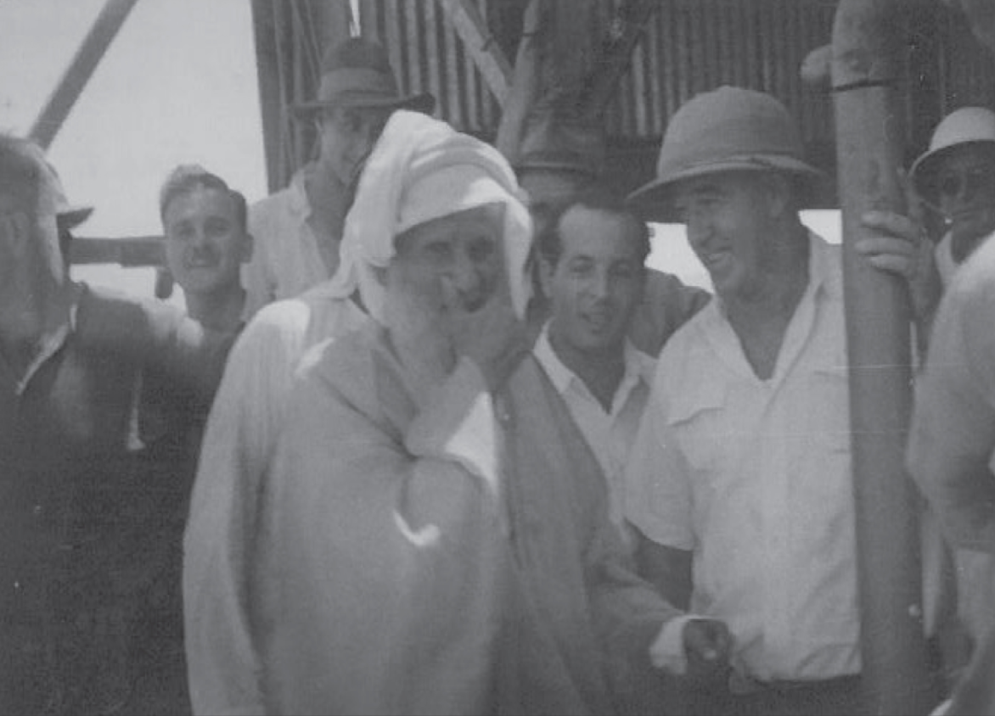
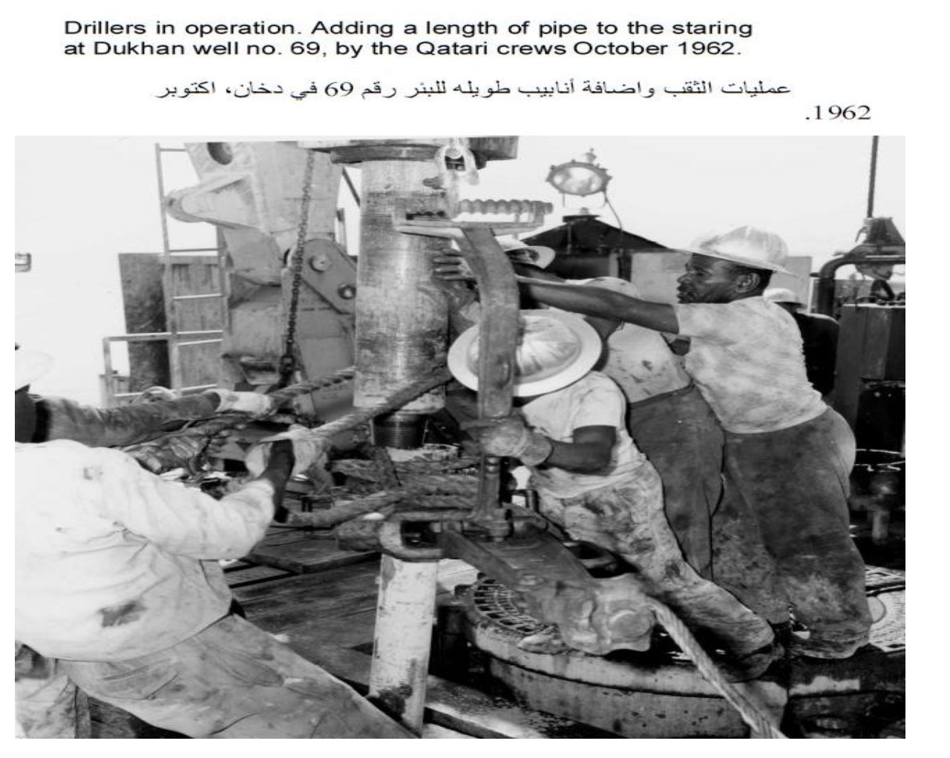
The Technoscientific, Historical, and Social Dimensions of the Oil and Gas Industry in Qatar
Albertus Retnantoª, Anto Mohsin^{b}, Afsha Shaikhª, Darrell Pinotoan^{b}, and Insha Shaikhª
a – Texas A&M University at Qatar b - Northwestern University in Qatar
INTRODUCTION
Oil and Gas has been a massive contributor to the growth and development of Qatar as a nation and the wider Gulf region. With the importance of the oil and gas industry to the nation in mind, this multiversity collaboration between TAMU-Q and NU-Q aims to develop an online open educational resource (OER) hosted on a website that will cover the techno-scientific, historical, and social aspects of the oil and gas industry in Qatar. Thus far, coverage of the oil and gas industry in Qatar is one-dimensional and has only focused on one of those mentioned aspects at a time. We thought it was important to have an interdisciplinary approach to learning about this key industry in Qatar and presenting it in a way that any person on the internet without prior knowledge would be able to understand.
MODULES
Module 1 covers in-depth the process of discovery, exploration and production of oil and gas in Qatar. Additionally, it also discusses briefly on the LNG and GTL production in Ras Laffan. This module has been peer reviewed by NU-Q students and revised based on their suggestions. Module 2 explores the discovery of oil and gas in Qatar as well as its labor history and also touches upon similar information from each country in the Gulf region for added context. This module will be peer reviewed by TAMU-Q students and revised based on their suggestions. Module 3 will present information on the experiences of female and male engineers and managers of multinational and national oil and gas companies with a particular emphasis on the female employees found in these organizations.
Dukhan outcrop – It is situated in the southeastern areas of Qatar and was discovered in 1932 by two geologists, E.W. Shaw and P.T. Cox. The first three months in 1933 were spent on surveying the Dukhan anticline where they discovered the presence of Eocene limestone within the surface rocks in the area similar to where the oil was discovered in the field in Bahrain.
Photo courtesy of QatarEnergy
The first well – Dukhan No. 1 in October 1938 surrounded by British engineers and local Qatari workers. The well was drilled by Qatar Petroleum Company for a total depth of 5,685ft (1,733m) and completed for 5,000 barrels per day on 8th January 1940.
Image courtesy of GeoExpro, February 2010
A rare photo of one of Qatar’s oil pioneers, Mansour bin Khalil Al-Hajri, in 1933, just before he lost his eyesight.
Al-Hajri had almost photographic memory of every inch of Qatari territory to the point that he could describe an area’s topographical formation and history all from memory. A British geologist at the time noted in a report that he “seems to have a mental map of the country and can find his way to any place, whether in a heat haze, fog, or even in total darkness”
(QatarEnergy.com, n.d.).
Drillers in Operation as they add a length of pipe at Dukhan Well No. 69 by Qatari crews in October 1962.
Photo courtesy of QatarEnergy
Photo courtesy of QatarEnergy
Sheikh Abdulla bin Jassim Al Thani, the second ruler of Qatar just after he had pushed in the clutch to start Well No. 4 on September 23, 1947.
METHODS
Archival Research to find primary and secondary sources on the oil and gas industry in Qatar both online and offline. In-person research was done through visits to the Company House, Qatar National Library, National Museum of Qatar and Gulf Times Library. Conducted interviews with female and male petroleum and chemical engineers and managers in the oil and gas industry about their professional experience in the oil and gas industry. Interviews were then analyzed with keyword-focused textual analysis software (LancsBox).
Photo courtesy of QatarEnergy
QUOTES FROM MODULE 3 INTERVIEWS:
“In the Middle East, there’s a view that, you know, a girl shouldn’t be doing this kind of work”
- Ghaida Al-Farsi, Field Engineer, BP Oman
“There has to be a culture of inclusivity, diversity and sustainability as well for the environment [in the industry]”
- Amit Singh, Managing Director, Schlumberger-Qatar
“Policy changes need to happen for the industry to be more inclusive to females”
- Lama Al-Oreibi, Reservoir Engineer, Qatar SHELL GTL Ltd.
ACKNOWLEDGEMENT
This work was supported by the 2021 Transformative Educational Experiences Grant, funded by the Center for Teaching and Learning at Texas A&M University at Qatar. Special thanks to the Petroleum Engineering Department at TAMUQ and Northwestern University – Qatar for their valuable input.
Notes:
Add some statistics from interviews.
Too much of text.
Add title in the top with the team info
Ctl logo at the bottom (sponsor)
Add word cloud to the third module section
OER in final deliverable

